Slide 1

JAWAHARLAL NEHRU TECHNOLOGICAL UNIVERSITY HYDERABAD UNIVERSITY COLLEGE OF ENGINEERING MANTHANI Centenary Colony, Pannur (Vill), Ramagiri (Mdl), Peddapally-505212, Telangana (India)
Department of Computer Science & Engineering
AUTOMATIC LICENSE NUMBER PLATE RECOGNITION
Under the guidance of
Mr. G. SRIDHAR
(Assistant Professor of CSE)
Team Members:
S. RAMKUMAR (21VD5A6612)
G. SRI VAISHNAVI (20VD1A6652)
B. SHANMUKH (20VD1A6639)
K.DIVYA SRI (20VD1A6613)

Slide 2
Contents
Introduction
Problem Statement
Existing System
Demerits of Existing System
Proposed Solution
Software requirements specification
Model Architecture
Model Design
Implementation
Conclusion
References

Slide 3
INTRODUCTION
The rapid advancement in information technology has led to a demand for integrating vehicle management into information systems.
This addresses challenges posed by increasing vehicle numbers and parking inefficiencies in educational institutions and multi-storey buildings.
Integrating traditional image processing, machine learning, and advanced deep learning techniques such as CNNs, object detection models, LSTM networks, and CTC loss forms the foundational framework for achieving high accuracy in Automatic Number Plate Recognition (ANPR) systems.

Slide 4
PROBLEM STATEMENT
There is no standard format followed, with high variation in fonts, sizes, colors, additional decorations etc. This makes localization and segmentation difficult.
In our daily life because of unlimited increase of vehicles and transportation system, it makes more and more difficult to fully manage and monitor traffic density.
Security cameras provide low resolution video feeds which pose difficulties for character recognition. Techniques are needed to work with limited resolution.

Slide 5
EXISTING SYSTEM
In India, number plate standards exist but are inconsistently followed, leading to wide variations in font type, character size, plate location, and the presence of unwanted characters.
Some prior methods use neural networks but only focus on certain recognition tasks like state detection. They do not cover the full pipeline from detection to recognition.

Slide 6
DEMERITS OF EXISTING SYSTEM
Efficient Law Enforcement
Traffic Management
Automated Toll Collection
Vehicle Recovery

Slide 7
PROPOSED SYSTEM
The proposed system uses "Otsu's method" for pre-processing and "feature-based localization" for number plate localization. This provides good results for handling the variations seen in Indian number plates.
The system proposes a new "Inception ResnetV2" algorithm for character segmentation. This aims to provide improved reliability and time optimization.

Slide 8
SOFTWARE REQUIREMENTS SPECIFICATIONS (SRS)
SOFTWARE REQUIREMENTS :
Programming Languages : Python(3.7 or above)
Front End : HTML , CSS , JS
Database : Sqlite3
Libraries :
NumPy
Pandas
Pytesseract OCR
Keras
Flask
HARDWARE REQUIREMENTS
Processor : Intel core i3 / Ryzen 3 or Above
RAM : 4GB or Above
ROM : 500 GB (HDD)or Above

Slide 9
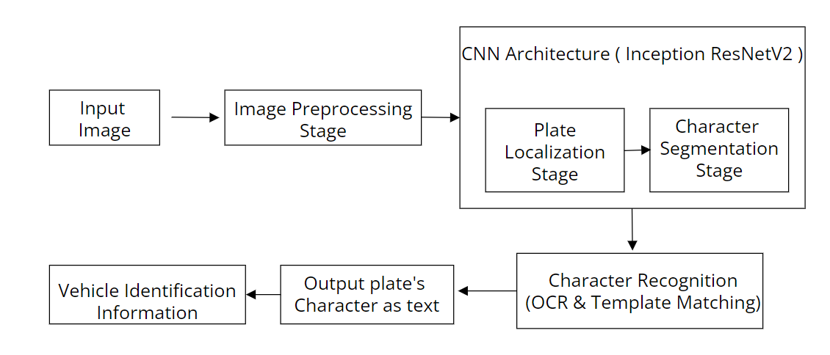
MODEL ARCHITECTURE

Slide 10
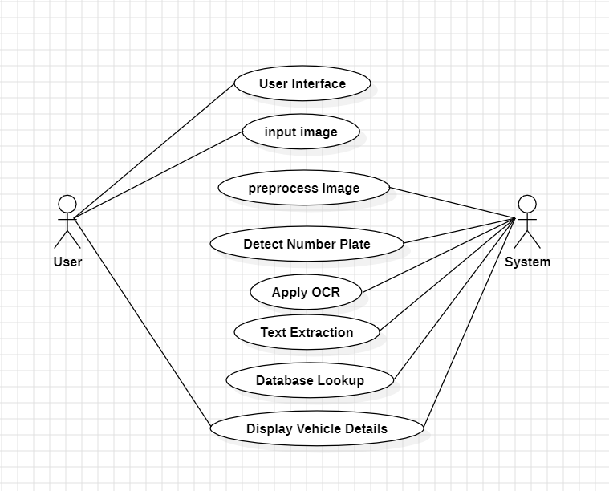
MODEL DESIGN
USECASE DIAGRAM

Slide 11
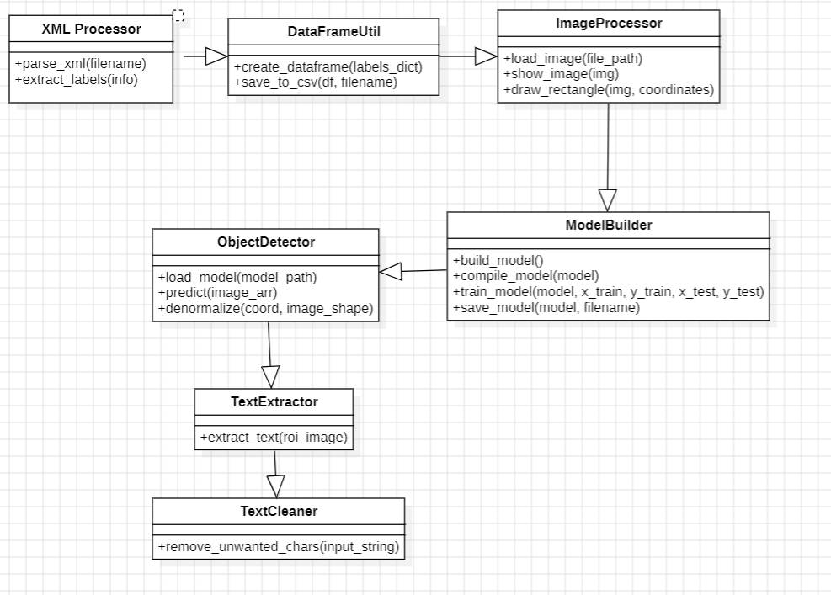
MODEL DESIGN
CLASS DIAGRAM

Slide 12
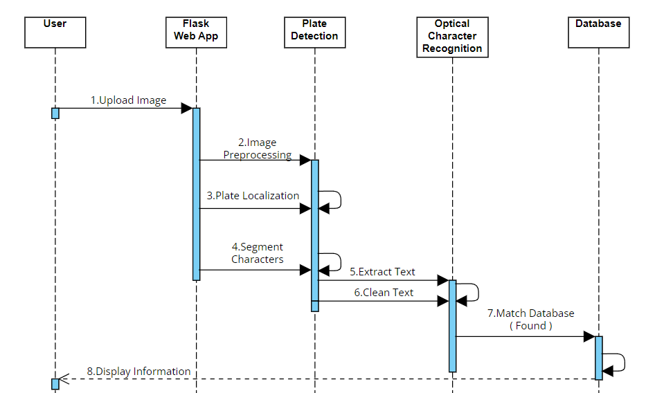
MODEL DESIGN
SEQUENCE DIAGRAM

Slide 13
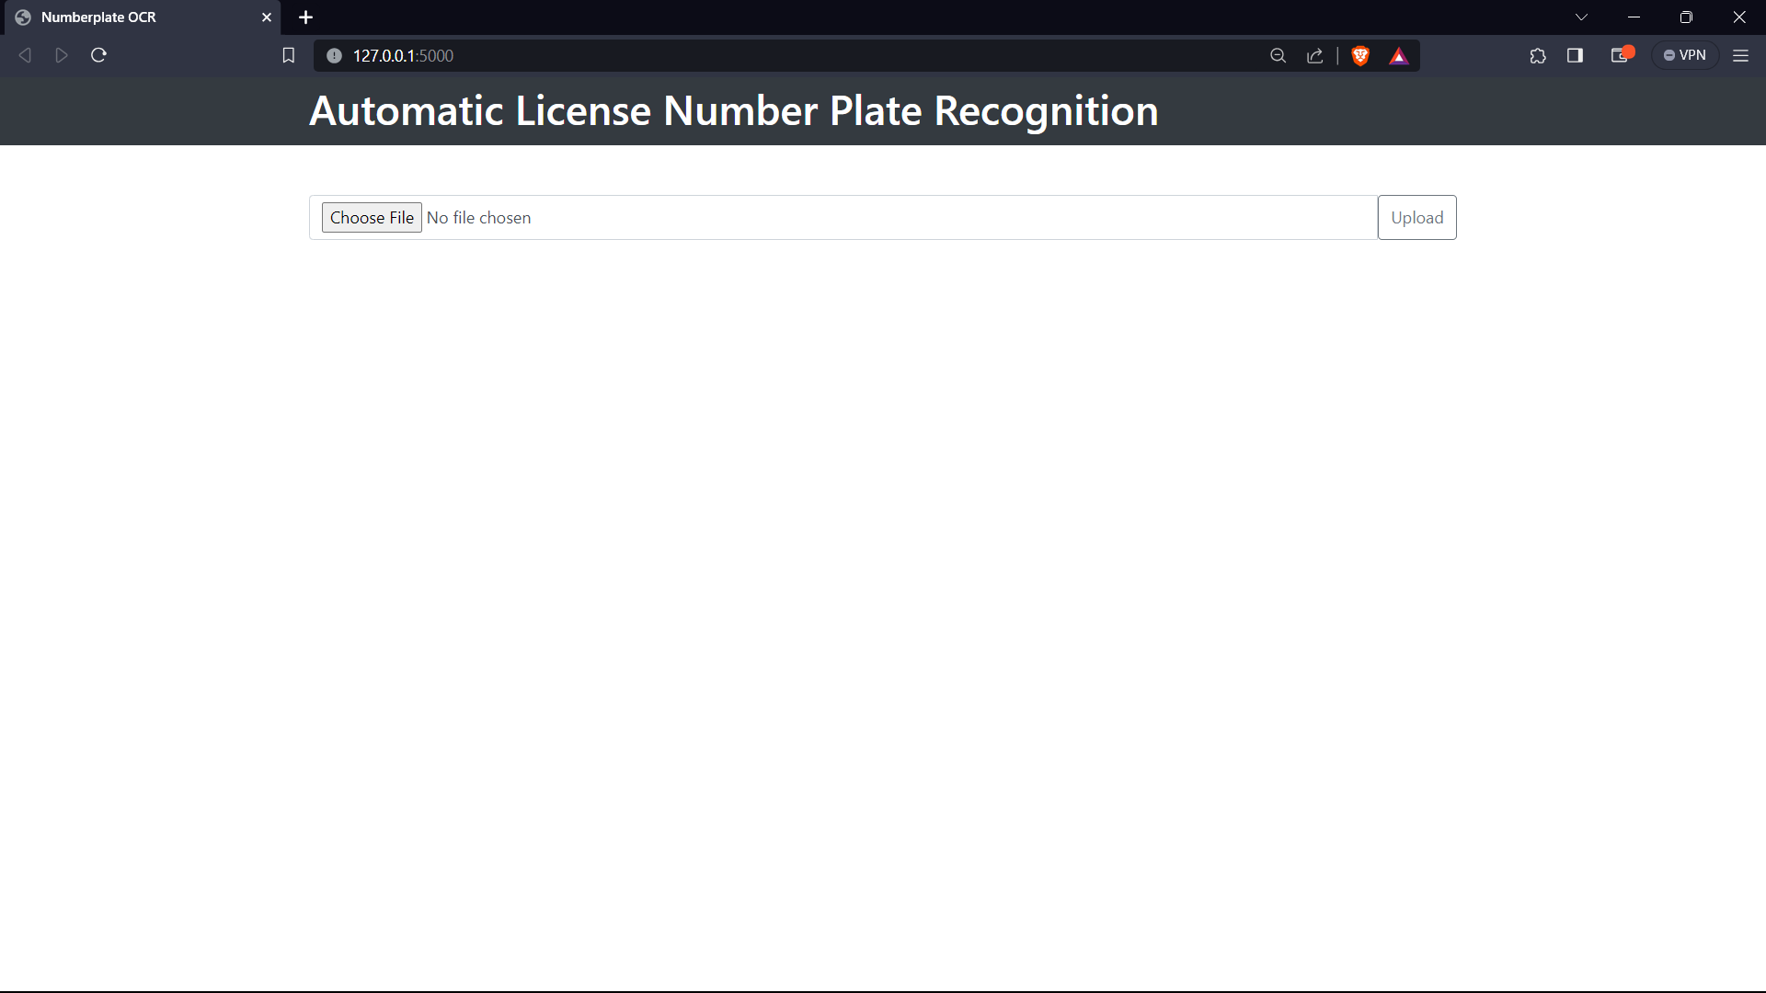
IMPLEMENTATION

Slide 14
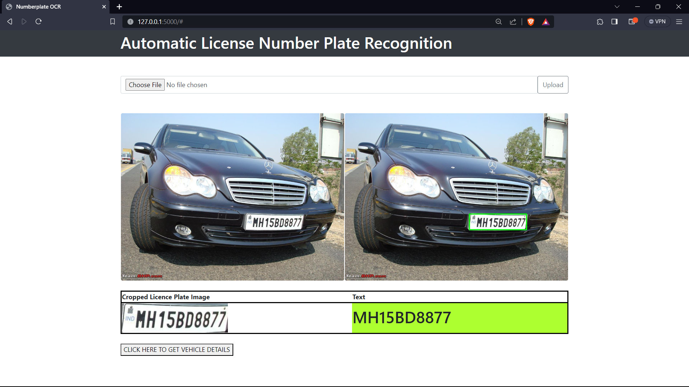
IMPLEMENTATION

Slide 15
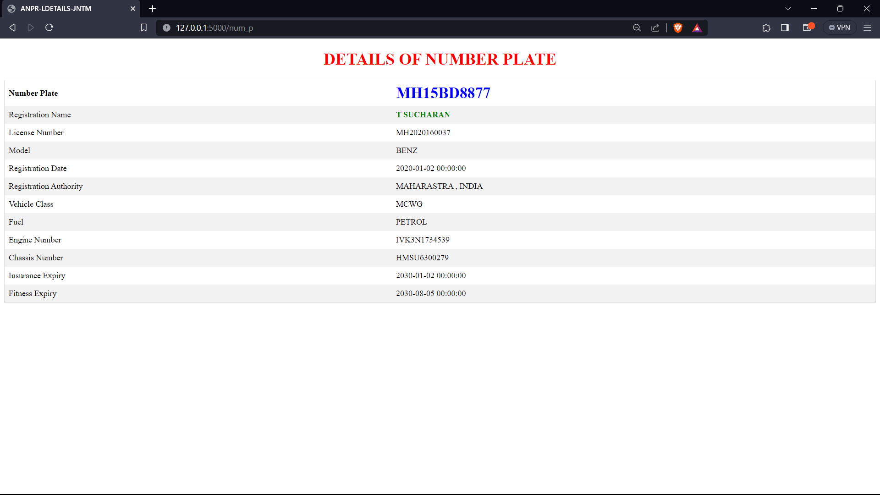
IMPLEMENTATION

Slide 16
CONCLUSION
The proposed algorithm exhibits strong recognition performance and compatibility, particularly in identifying diverse license plates under challenging conditions such as weaker illumination and complex backgrounds.
The integrated method of object detection, optical character recognition (OCR), and registration details retrieval in image-based vehicle identification improves recognition accuracy and streamlines processes, fostering greater efficiency in law enforcement and vehicle recovery efforts

Slide 17
REFERENCES
[1]Chirag Patel, Dipti Shah, Atul Patel, “ANPR: A International Conference on Advances in Computing, Communication Control and Networking (ICACCCN2018)”.
[2] Ying Wen et al., "An Algorithm for License Plate recognition Applied to Intelligent Transportation System," IEEE Transactions of Intelligent Transportation Systems, pp. 1-16, 2011.
[3] Fikriye Ozturk and Figen Ozen, "A New License Plate Recognition System Based on Probabilistic Neural Networks," Procedia Technology,vol.1,pp.124-128,2012.

Slide 18
THANK YOU!

